Slide 1
RRM-local Anomaly Detection (v1)
Ruchit Mehta
Wenfeng Wang
Amit Pillay
Shirley Wu
03/17/2021

Slide 2
Workflow
Problem
EDA
Basic data cleaning and statistical analysis
Time-series decomp for seasonality and trend
Model selection
Time-of-day model to capture daily seasonality (global)
Median and IQR to define robust uncertainty bounds using history data
Setup baseline for RRM channel-switching
Detect excursions and generate alarms
Segment RRM channel-switching by command-reason
Deploy
Create spark_jobs aggregator (Amit) and event_generator
Create airflow DAG for hourly event generation (Amit)
Persist anomaly count and scores in S3 and send to SignalFX

Slide 3
RRM-local command-reason categories
acs-request-ap <> acs-request-ap | rrmL-acs
capacity-anomaly <> non-wifi | wifi-cochannel
marvis-action-check <> disable-radio | reset-radio
rrm-global <> rrmG-ondemand | rrmG-scheduled
rrm-radar <> post-radar | radar-detected
scan-anomaly <> non-wifi | wifi-cochannel | wifi-cochannel-external

Slide 4
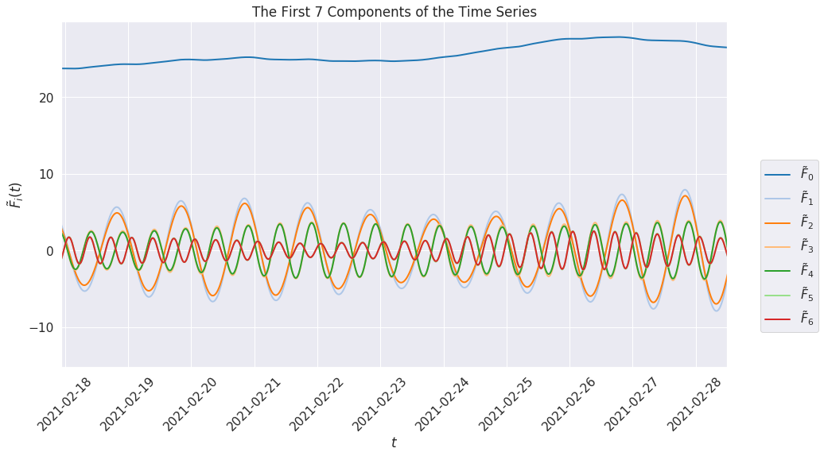
Time-series decomposition
Singular spectrum analysis
slowly varying trend → Assumed constant
1Day
Daily seasonality is dominant along with other higher frequency components

Slide 5
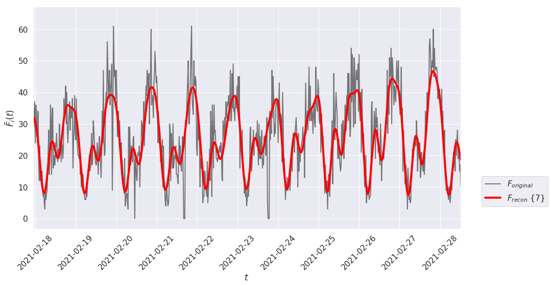
Time-series decomposition
Daily and sub-daily components are good indicators to generate a time-of-day model

Slide 6
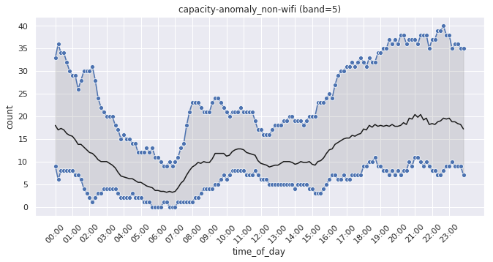
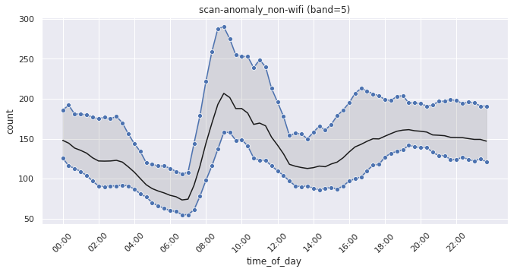
Model build and verification
Median and IQR trend computed every time-of-day point (robust to outliers in training data)
Gaussian smoothing to remove artifacts
Upper bound = Median + 2.5*IQR
Anomaly==True if Count > upper bound
Anomaly score = (Count – Median ) / IQR
Average score = Sum(event scores) / #events

Slide 7
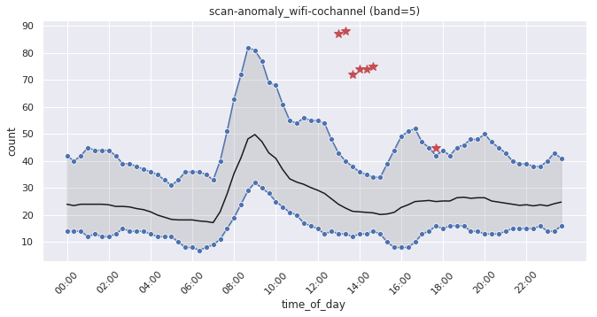
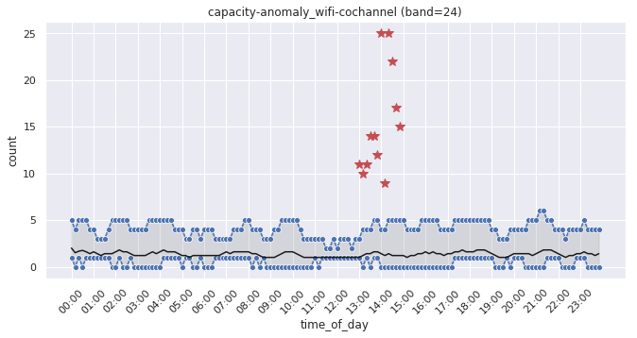
Model build and verification
RRM excursion on 03/08/2021

Slide 8
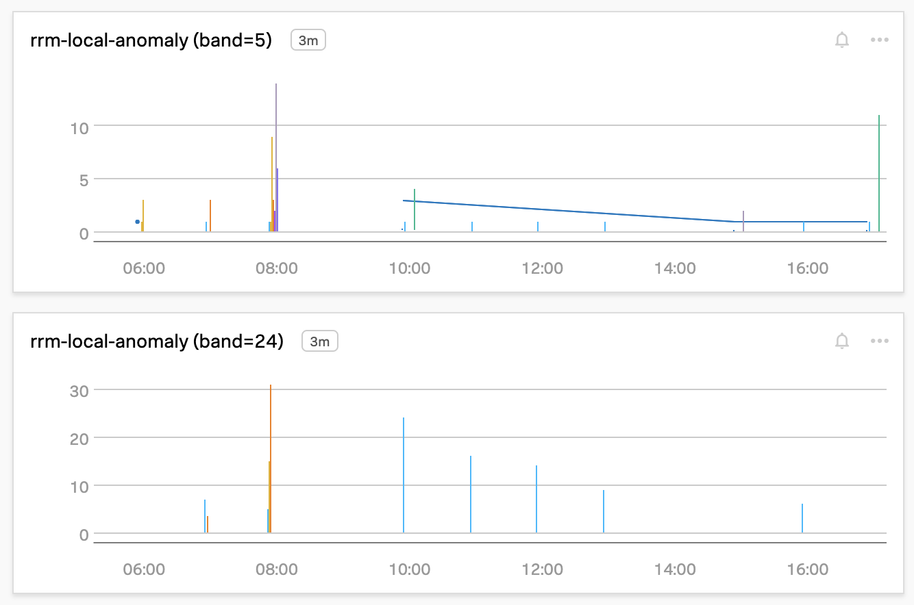
SignalFX
Bars = Average anomaly_score (per_hour)
Lines = anomaly_count (per hour)

Slide 9
Implementation details

Slide 10
Data Aggregation
Source bucket: mist-secorapp-<env>/rrm-local/rrm-local-<env>
Entity Fields:
org_id
site_id
band
command
reason
timestamp
Aggregation: Every hour, we look at the past hour’s source data, for each group of (org, site, band, command, reason) we round the timestamp to floor to 10th min and then count the number of entries
Destination bucket: mist-aggregated-stats-<env>/aggregated-stats/rrm_local_cmd_count
Airflow: Runs hourly as a part of “stats_and_consumer” dag

Slide 11
Sample Aggregated Data
Row(org_id='810064a3-9792-45d9-9dd0-408cdf87b017', site_id='ddc6d36c-a03a-41f6-962f-ebb9ff13c54d', band='5', command='scan-anomaly', reason='wifi-cochannel-external', timestamp=1613010000, rrm_local_cmd_count=1, stats_agg_time=1613008800),
Row(org_id='5a578f3c-f094-4d13-a7dd-96f0aaecb5b6', site_id='4d63a5b1-0168-4338-b176-cf068b0244d1', band='5', command='rrm-global', reason='rrmG-scheduled', timestamp=1613010000, rrm_local_cmd_count=12, stats_agg_time=1613008800)

Slide 12
Event Generator
Source Bucket: mist-aggregated-stats-<env>/aggregated-stats/rrm_local_cmd_count
Anomaly Detection and Scoring
Rrm Local Anomaly event generator loads the pretrained model from cloud
Reads each previously aggregated data row, identify what type of command and reason associated with it
Construct the feature set from input columns and then use model to check if there is an anomaly and what is the anomaly severity score
Model basically use Inter-Quartile Range to identify whether a given combination of input feature set is anomaly or not
Then finally anomaly score is persisted back to cloud
Destination Bucket: mist-aggregated-stats-<env>/aggregated-stats/rrm_local_anomaly_candidates/
Airflow: Runs hourly as a part of “hourly_event_generation” dag

Slide 13
Sample Output Anomaly Data
[Row(time_of_day='08:00', band='5', command-reason='scan-anomaly_wifi-cochannel-external', rrm_local_cmd_count=286, anomaly='true', anomaly-score='2.8085106382978724’)]
[Row(time_of_day='23:40', band='24', command-reason='rrm-global_rrmG-scheduled', rrm_local_cmd_count=197, anomaly='true', anomaly-score='8.35344827586207')]

Slide 14
Improvements
Separate out and model the effect of day_of_week and weekend/holidays
Decompose data at site-level to check if excursion is site-related or “global”
Automate model training with quick validation

Slide 15
APPENDIX

Slide 16
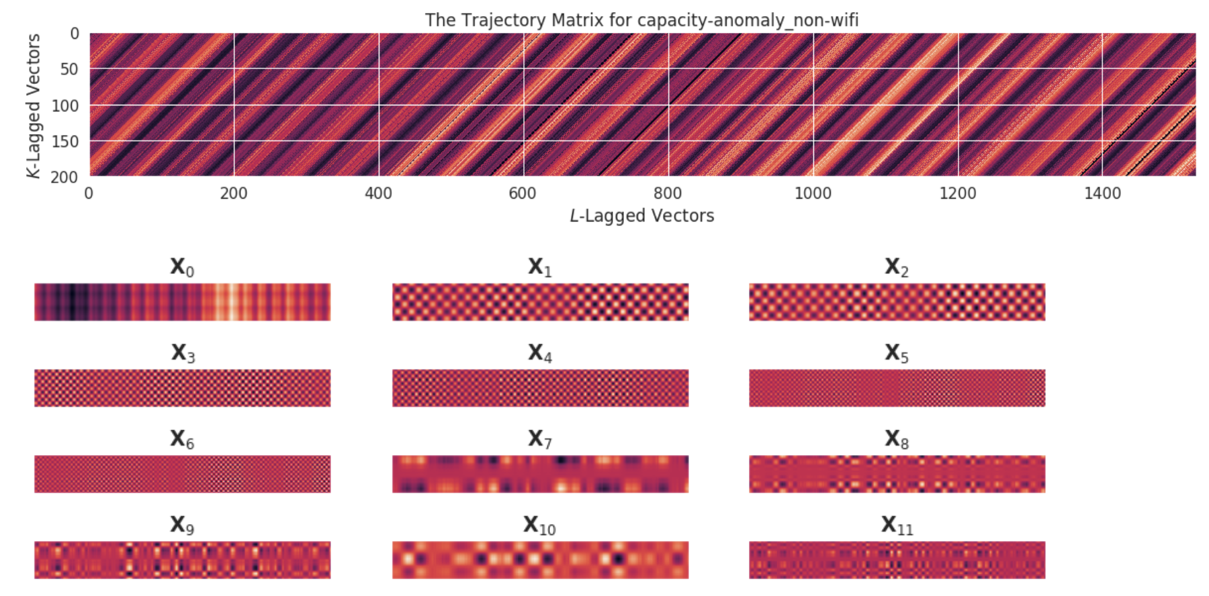
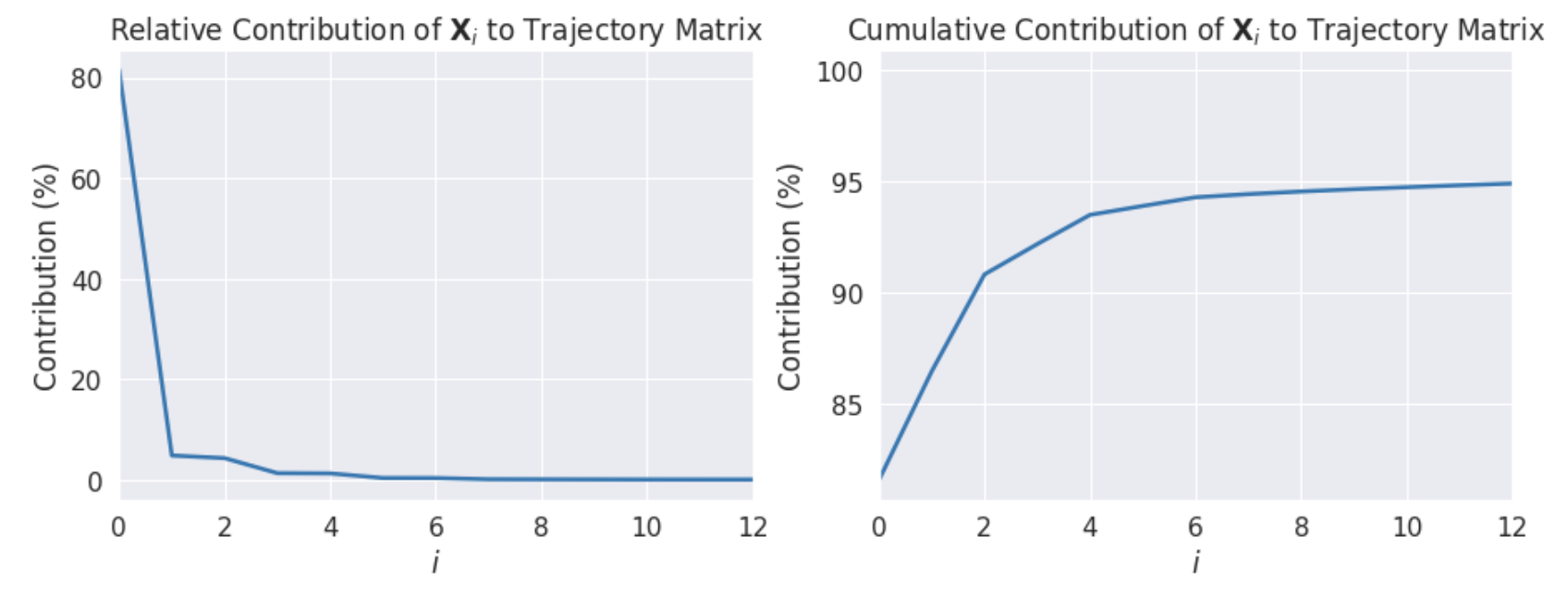
Singular spectrum analysis
Similar to PCA but for time series
Create trajectory matrix of lagged vectors from time-series and use SVD to get eigenvectors

